Slide 1
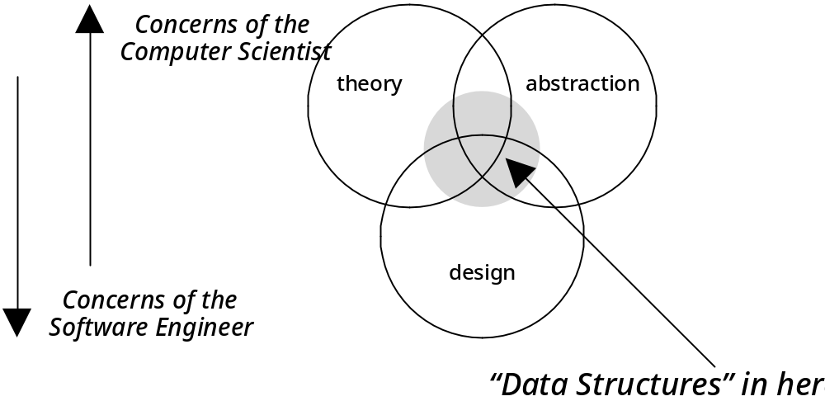
Figure 1-1: The concerns of the computer scientist and the software engineer

Slide 2
Definition 1-1
  A data structure consists of a base storage method (e.g., an array) and one or more algorithms that are used to access or modify that data.

Slide 3
Code Example 1-1: A program demonstrating a dice data structure (part 1 of 2)
// cx1-1.cpp
// Code Example 1-1: a dice program that does not use an adt
//
// Illustrates the solution to a "dice simulation", without using
// abstract data types. Compare this approach to cx1-2.cpp.
#include "dslib.h" // contains standard header files for this book
#include <stdlib.h>
int main()
{
int die1, die2, total;
randomize(); // initialize the pseudorandom number generator

Slide 4
Code Example 1-1: A program demonstrating a dice data structure (part 2 of 2)
die1 = random(6) + 1;
// random(6) returns random number between 0 and 5
die2 = random(6) + 1;
total = die1 + die2;
cout << "first die: " << die1 << ", second die: " << die2 << endl;
cout << "total for roll is: " << total << endl;
return 0;
}

Slide 5
Definition 1-2
An Abstract Data Type (ADT) is a well-specified collection of data and a group of operations that can be performed upon the data. The ADT’s specification describes what data can be stored (the characteristics of the ADT), and how it can be used (the operations), but not how it is implemented or represented in the program.

Slide 6
ADT 1-1: Dice
(part 1 of 2)
Characteristics:
  Represents a pair of 6-sided dice, that can be rolled to get a random sum between 2 and 12.
Operations:
  int roll()
    Precondition: none.
    Postcondition: A random value between 1 and 6 is stored for each of the dice.
    Returns: The sum of the two dice values, lying between 2 and 12.

Slide 7
ADT 1-1: Dice
(part 2 of 2)
  int die1()
    Precondition: The dice have been rolled at least once.
    Postcondition: None.
    Returns: The value of the first die.
  int die2()
    Precondition: The dice have been rolled at least once.
    Postcondition: None.
    Returns: The value of the second die.

Slide 8
Code Example 1-2: A program using a Dice ADT (part 1 of 4)
// cx1-2.cpp
// Code Example 1-2: a dice program that uses an adt
//
// Illustrates the solution to a "dice simulation", using
// abstract data types. Compare this approach to cx1-1.cpp.
//
// Dice ADT
//
// Characteristics:
// Represents a pair of 6-sided dice, that can be rolled to get a
// random sum between 2 and 12.
//

Slide 9
Code Example 1-2: A program using a Dice ADT (Part 2 of 4)
// Operations:
// int roll()
// Preconditions: none
// Postcondition: A random value between 1 and 6 is stored for each of
// the dice.
// Returns: The sum of the two dice values, lying between 2 and 12
// int die1()
// Precondition: The dice have been rolled at least once.
// Postcondition: None
// Returns: The value of the first die.
// int die2()
// Precondition: The dice have been rolled at least once.
// Postcondition: None
// Returns: The value of the second die.

Slide 10
Code Example 1-2: A program using a Dice ADT(part 3 of 4)
// Note on encapsulation: The representation of the dice is contained // within global variables -- we'll see shortly a better way to do
// this.
#include <iostream.h>
#include <stdlib.h>
#include "dslib.h"
int dice_1, dice_2;
int roll()
{
// note -- you don't really want to call randomize every time you // roll the dice, but for this simplified design you don't have // much choice.
randomize();
dice_1 = random(6) + 1;
dice_2 = random(6) + 1;
return dice_1 + dice_2;
}

Slide 11
Code Example 1-2: A program using a Dice ADT(Part 4 of 4)
int die1()
{
return dice_1;
}
int die2()
{
return dice_2;
}
// end of Dice ADT
int main() // test program to demonstrate Dice ADT
{
cout << "The value rolled is: " << roll() << endl;
cout << "The first die was: " << die1() << endl;
cout << "The second die was: " << die2() << endl;
return 0;
}

Slide 12
Figure 1-2: One version of the waterfall model of software development
Initiation
Analysis
Design
Implementation
Testing
Maintenance

Slide 13
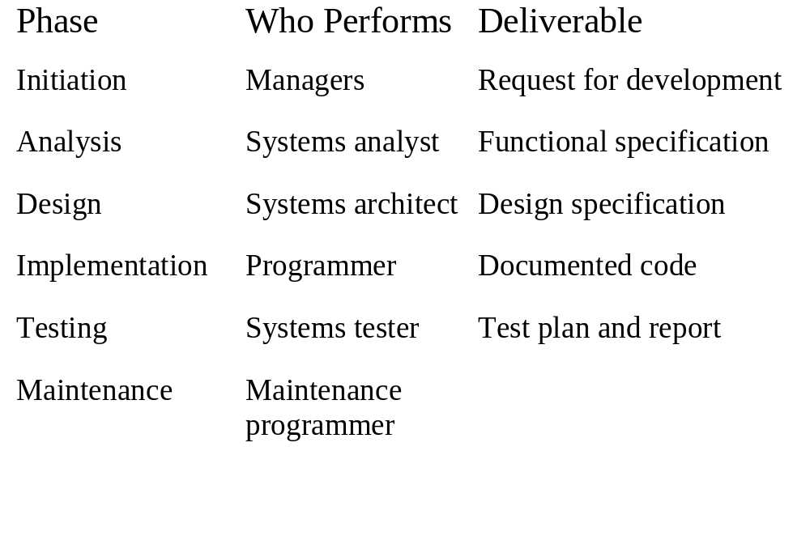
Table 1-1: The waterfall model:
A summary of the players and the deliverables

Slide 14
Agile model
Incremental model
  Software is developed in incremental, rapid cycles
  Small Incremental releases with each release building on previous functionality
  Each release is thoroughly tested
0. Kickoff
  Sprint planning
  Dev
  Test -> then deployment
  Demo
  Repeat 1 through 4 -> incremental releases

Slide 15
Transparency Masters for
Chapter 3 of
Data Structures via C++
Objects by Evolution
A. Michael Berman
Copyright © 1997
Oxford University Press
All Rights Reserved

Slide 16
A Taxonomy of Errors
System Errors
Validity Errors: logic error
Verification Errors: system requirements analysis failure
Run-Time Errors: mainly from misuse of memory and divide by zero
Maintenance Errors

Slide 17
Approaches to Testing
Black-box vs. Glass-box
  black-box:only the inputs and outputs are considered
  glass-box:consults the source code to design test
Unit vs. System
  unit: testing of individual pieces
  system(functional): functional requirements
  beta testing

Slide 18
Guidelines for Creating Test Plans
1. Test typical cases
2. Test extreme cases
3. Test invalid inputs

Slide 19
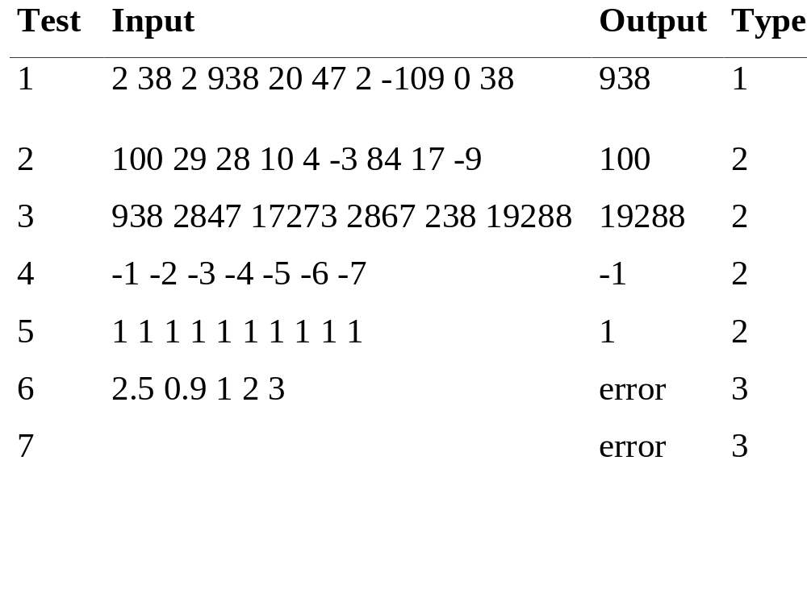
Table 3-1: Test plan for Max program

Slide 20
Two techniques for unit testing
Drivers
  a program only for testing
Stubs
  a placeholder for the function that hasn’t been written

Slide 21
Code Example 3-1: Test driver for max function
(Part 1 of 2)
// cx3-1.cpp
// Code Example 3-1: Test Driver for Max Function
#include <iostream.h>
int max(int a[], int n);
// defined in cx3-3.cpp; link with the driver
int main()
{
int a[100], i;
cout << "Max driver\n";
cout << "Enter each input to max terminated by -9999\n";
cout << "Length of input must be <= 100\n";

Slide 22
Code Example 3-1: Test driver for max function
(Part 2 of 2)
for (i = 0; i < 100; i++) {
int val;
cin >> val;
if (val == -9999) // termination sentinel
break;
else
a[i] = val;
}
cout << "\nMax is " << max(a, i) << '\n';
cout << "\n\n";
return 0;
}

Slide 23
Code Example 3-2: Sample stub for function median
// cx3-2.cpp
// Code Example 3-2: Stub for Median Function
#include <iostream.h>
int median(int a[], int n)
{ // This is a stub for function median
cout << "function median called with n = " << n << ", a[] = ";
int i;
for (i = 0; i < n; i++)
cout << a[i] << '\t';
cout << "\nType in value you want median to return:";
int return_value;
cin >> return_value;
return return_value;
}

Slide 24
Applying program correctness technique
Assertions: precise statement about the behavior of a program at a particular spot
  Preconditions
  Loop invariants: holds on each iteration
    true for the first time
    true for the next if the current is true
  postconditions

Slide 25
Code Example 3-3: Function max
// cx3-3.cpp
// Code Example 3-3: max function
int max (int a[], int n)
{
// assertion 1: a is an array with subscripts ranging from 0 to n-1
int max_val(a[0]), i;
for (i = 1; i < n; i++)
// assertion 2: (max_val >= a[k] for 0 <= k < i) and
// (max_val = a[j] for some j, 0 <= j < i)
if (max_val < a[i])
max_val = a[i];
// assertion 3: (max_val >= a[k] for 0 <= k < n) and
// (max_val == a[j] for some j, 0 <= j < n)
// i.e., max_val is equal the value of largest int in array a
return max_val;
}

Slide 26
Figure 3-1: Illustrated loop invariant for function max
i
max_val >= everything in here
this part is unknown

Slide 27
Steps for Analyzing a Loop
1. Establish the precondition
2. Find the invariant
3. Establish the postcondition
4. Prove termination

Slide 28
Code Example 3-4: sum function
// cx3-4.cpp
// Code Example 3-4: sum function
int sum(int a[], int n)
{
// Precondition: a is an array with subscripts ranging from 0 to n-1
int i;
int total(0);
for (i = 0; i < n; i++)
// Loop invariant: total = a[0] + a[1] + ... + a[i]
total += a[i];
// Postcondition: total = a[0] + a[1] + ... + a[n-1]
return total;
}

Slide 29
Figure 3-2: Basic idea of Insertion Sort
23
7
11
17
26
33
7
11
17
23
26
33
Unprocessed Items

Slide 30
Code Example 3-5: Insertion Sort
// cx3-5.cpp
// Code Example 3-5: Insertion Sort
void insertNextItem(int a[], int i); // in cx3-6.cpp
void insertionSort(int a[], int n)
{
// Precondition: a is an array with subscripts ranging from 0 to n-1
int i;
for (i = 1; i < n; i++)
// Loop invariant: items in range from 0 to i-1 are sorted;
// items from i to n-1 have not yet been examined.
insertNextItem(a, i); // see cx3-6.cpp
// Postcondition: array a is sorted
}

Slide 31
Code Example 3-6: InsertNextItem
// cx3-6.cpp
// Code Example 3-6: insertNextItem (used by Insertion Sort)
void insertNextItem(int a[], int i)
{
// Precondition: array a is sorted from 0 to i-1
int newItem(a[i]), insertPos(i);
for ( ; insertPos && newItem < a[insertPos-1]; insertPos--)
// Loop Invariant: newItem <= a[insertPos+1] .. a[i] &&
// a[insertPos+1] .. a[i] are sorted
a[insertPos] = a[insertPos-1];
a[insertPos] = newItem;
// Postcondition: array a is sorted from 0 to i
}

Slide 32
실습 예제
3장에서 배운 Insertion sort를 구현한다.
  먼저 입력 받는 부분을 구현한다.
    입력될 integer 개수를 n 개를 먼저 입력받음
    N 개의 integer array를 생성하고
    Loop 를 통해서 n 개 integer를 받아서 array에 넣음.
  Insertion sort 코드를 배운대로 구현
    구현된 코드를 불러서 정렬
  출력함.

Slide 33
실습에 필요할지도 모를 코드
#include <iostream.h>
#include <stdio.h>
using namespace std;
cin, cout
For(초기화;조건;후행연산){}
int *a;
a = new int [nSize];

